Slide 1

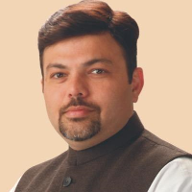
WORLD HEMOPHILIA DAY Celebration
Organized by
Hemophilia society Nagpur chapter
On 18th April 2021 (SUNDAY) at 12:00PM – 1:30PM
Our Chief Guest
Dr Ashish R. Deshmukh
Indian social worker, activist, philanthropist, and Ex member of the Maharashtra Legislative Assembly.
Special Invitees
Dr Amit Nemade (Pediatric Orthopedist)
Organizers
Dr Ayushree Deshmukh
President , Hemophilia Society Nagpur
Dr Vithalrao Dandge
Vice-President , Hemophilia Society Nagpur
Dr Anju Mehrotra Kadu
Secretary , Hemophilia Society Nagpur
Mr Pramod Kathale
Treasurer , Hemophilia Society Nagpur
Mr Rajesh Janbade
Jt. Secretary, Hemophilia society Nagpur
Mr Sadanand Choudhari
Jt. Secretary, Hemophilia society Nagpur
Our Executive Committee Members
Star Speakers
Mrs. Poornima Chavhan (Women Representative)
Dr Soumya Prakash
Vijay Chute
Harshad Meshram
Hrushikesh Malave
Dr Deepak Goyal
Mr. Pawan Mahajan (Youth Representative)
Mr. Saurabh Rathakanthiwar
Mr. Prashant Chaudhari
Adv. Sushit Soni
Mr. Vishal Somyani

